Slide 1
Information Visualization Project Proposal and Dataset
G13-A
83463 – Francisco Campaniço
83482 – João Rafael
83558 – Rodrigo Oliveira

Slide 2
INITIAL DATASET
01

Slide 3
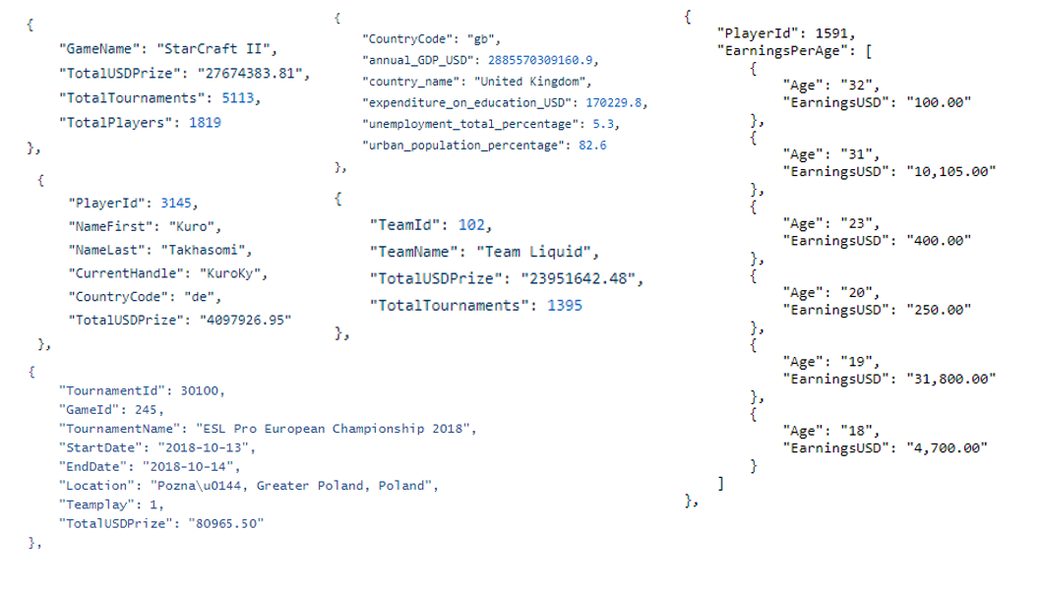
Initial Dataset
Description
Static tables from esportsearnings.com and worldbank.org’s APIs, and scraping from esportsearnings.com.
Data sample

Slide 4
Selected / derived data
02

Slide 5



Selected data
Data description
Our data gives us the ability to correlate several key aspects from esports such as earnings from players and tournaments or the unemployment rating of countries with the players that earn the most.

Slide 6
Derived data
Derived data description
We removed some unnecessary attributes from the other tables (such as the location/name of tournaments).
Some players don’t have their earnings by age available, so when we’re using that part of the table they will be ignored.

Slide 7
Data abstraction
03

Slide 8
Data abstraction
Players
Static table players.json, containing a player’s ID, their handle (“nickname”), country and total earnings.
Attributes:
playerId, currentHandle: nominal; both identify a player.
countryCode: nominal; two-letter code identifying the player’s nationality.
totalUSDPrize: quantitative, ratio; player’s total earnings.
earningsByAge: sub table with:
age: quantitative, ratio; player’s past or present age.
earningsUSD: quantitative, ratio; player’s earnings when he was the above age.

Slide 9



Data abstraction
Games
Static table games.json, containing a game’s name, its earnings (total prize), tournaments and players.
Attributes:
gameName: nominal; identifies a game.
totalUSDPrize: quantitative, ratio; the game’s total prize money.
totalTournaments: quantitative, ratio; number of tournaments for that game.
totalPlayers: quantitative, ratio; number of players for that game.

Slide 10



Data abstraction
Teams
Static table teams.json, containing a team’s ID, name, tournaments and earnings.
Attributes:
teamId, teamName: nominal; both identify a team/organisation.
totalTournaments: quantitative, ratio; number of tournaments the team participated in.
totalUSDPrize: quantitative, ratio; team’s total earnings.

Slide 11
Data abstraction
Countries
Static table countries.json, containing a country’s name, annual GDP, and unemployment/education/urban population metrics.
Attributes:
countryName, countryCode: nominal; both identify a country.
annualGDP_USD: quantitative, ratio; country’s annual Gross Domestic Product.
expenditureOnEducation_USD: quantitative, ratio; country’s education expenditures.
urbanPopulationPercentage: quantitative, ratio; country’s urban population.
unemploymentTotalPercentage: quantitative, ratio; country’s unemployment.

Slide 12
Tournaments
Static table tournaments.json, containing game and tournament IDs, start and end dates, and the total prize.
Attributes:
gameId, tournamentId: nominal; they identify the game played and the tournament respectively.
startDate, endDate: quantitative, hierarchical; start and ending dates for the tournament
totalUSDPrize: quantitative, ratio; tournament’s total prize pool.

Slide 13
Dataset processing
04

Slide 14



Dataset processing
Dataset cleaning description
The data for games, teams and players was obtained directly from the esportsearnings.com API.
Player earnings by age data was scraped from the same site (using a node.js script to go to each player’s “Tournaments won by age” page and making a .json file from it.)
Country data was obtained from the worldbank.org API in .xlsx format and converted to .json afterwards, with the use of a Python script.

Slide 15
Dataset processing
Problems found:
Players’ earnings by age weren’t available in the API
The API only let us get 100 players/tournaments/teams and 1 game at a time, with a maximum of 1 query every 2 seconds.
Solutions found:
Scraping each players page to get the data, since it’s available in plaintext.
Writing scripts for automating data collection.

Slide 16
Mapping
05

Slide 17
Mapping
What countries have the highest earnings?
Group players by countries and get the sum of their earnings.
What is the age at which players earn the most?
Compare each player’s earnings by age.
What organizations earned the most?
Sort the teams table by earnings.

Slide 18
Mapping
What games have the most earnings?
Sort the games table by earnings.
What months are the most active in esports?
Use the dates from the tournaments table.
How does unemployment correlate with player earnings?
Use the data from country and player tables.

